Slide 1





THE GOLDEN AGE OF VIDEO GAMES
An Analysis of : Critics Score - User Score -
Sales From 19's to 20's
Name - Alfaiz
RETRO GAMING
Project - Major
Date - 2025
1

Slide 2


INTRODUCTION
GOAL - TO OUTLINE PROJECT’S PURPOSE , QUESTIONS AND DATA SET
Objective - Identify the Golden Age of Video Games by
Analyzing : Sales , Quality and Impact
KEY QUESTIONS
1
2
3
4
5
6
What are the top 10 best-selling games and their release period?
Which years had the highest average critic scores and hit games (score ≥ 80)?
Which years had the highest average user scores and hit games (score ≥ 80)?
Which years had the highest combined critic/user scores and hits?
What were the total sales in these top years?
(New) How do platforms and genres contribute to the top 300 games’ sales?
READ MORE
2

Slide 3




METHODOLOGY
GOAL - MY GOAL IS TO EXPLAIN THE PROCESS AND TOOLS TO BUILD CREDEBILITY
CONTENT :
DATA CLEANING :
Removed duplicates, excluded/imputed missing values.
Normalized user scores (0–10 to 0–100).
Defined hits (scores ≥ 80 or top 25% sales).
Analysis: We Have Five questions plus platform/genre trends for top 300 games.
Tools: MySQL (queries), Power BI (visuals), CANVA (presentation).
Our mission
flow chart
IMPORT
QUERY
PRESENT
IMPORT
CLEAN
VISUALIZE
3

Slide 4
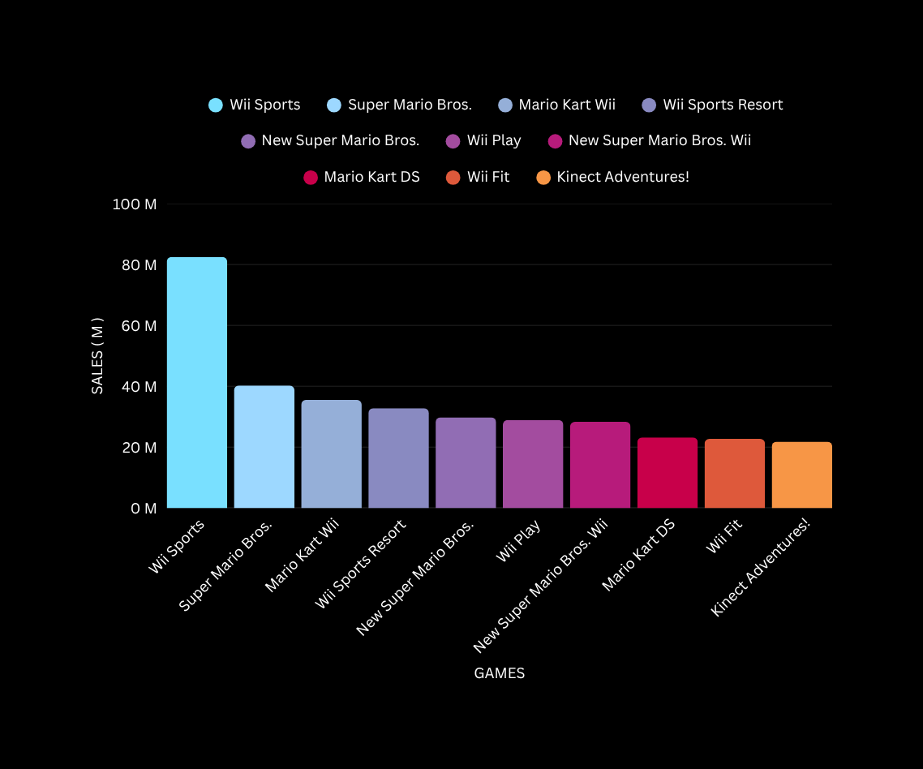
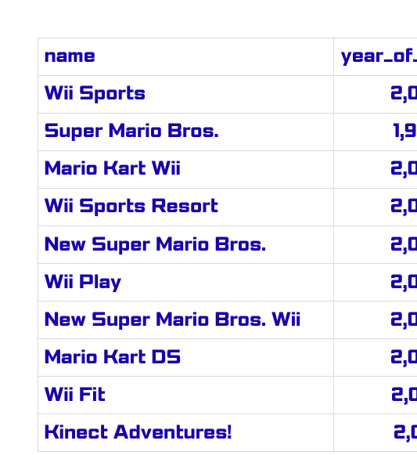

TOP 10 BEST SELLING GAMES
Insight: “Most top-sellers (2000–2010) reflect -
PlayStation 2 and Wii dominance.”
TABLE
“Wii Sports (2006) brought gaming to new audiences.”
4

Slide 5
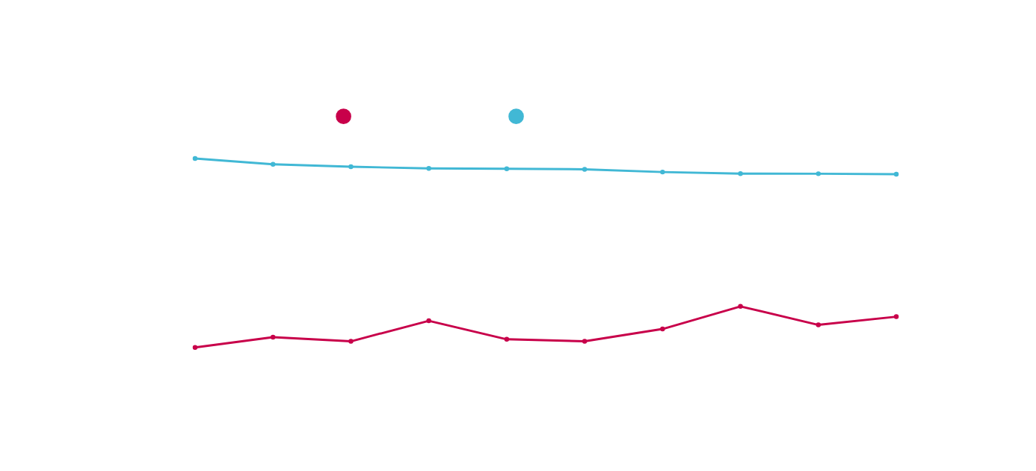





top 10 years by critic score’s
Goal: Show years with the highest
average critic scores and hits.
In 2020, two games achieved a 93 average critic score:
Half-Life: Alyx and The Last of Us Part II. Additionally,
Ori and the Will of the Wisps also earned a 93 average critic score.
5
GOD OF WAR
CALL OF DUTY
RESIDENT EVIL 4
TEKKEN 3

Slide 6
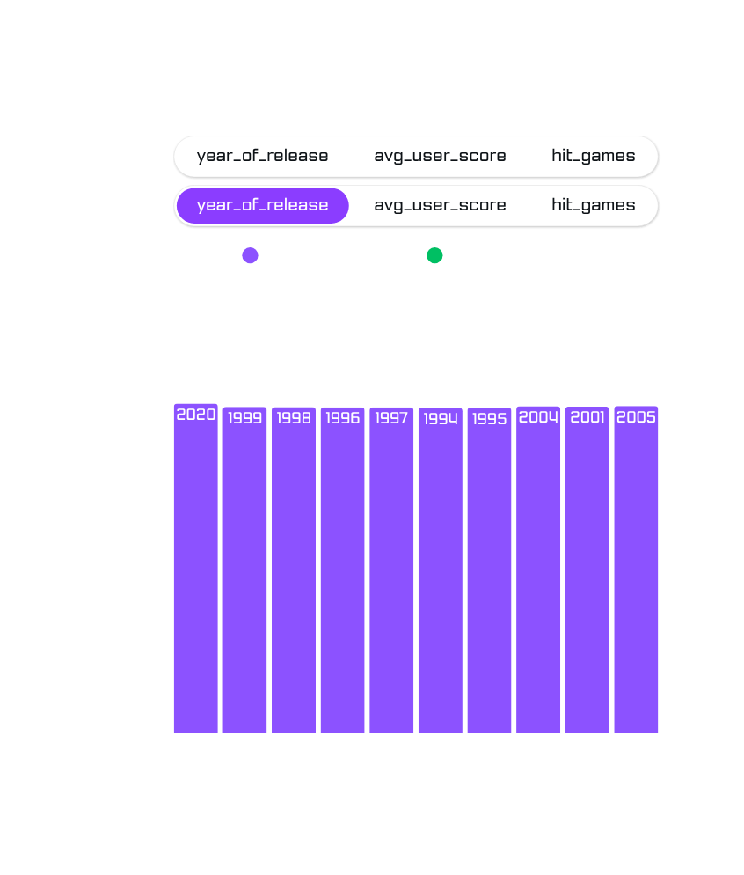


TOP 10 YEARS WITH AVG USER SCORE
HALF LIFE 2
A.
Insight: “Fans loved 1998 and 2004, aligning with critic peaks.”
b.
“2004: Fan-favorite gameplay shone.”
Goal: Highlight years with the highest average user scores and hits.
6
c.

Slide 7
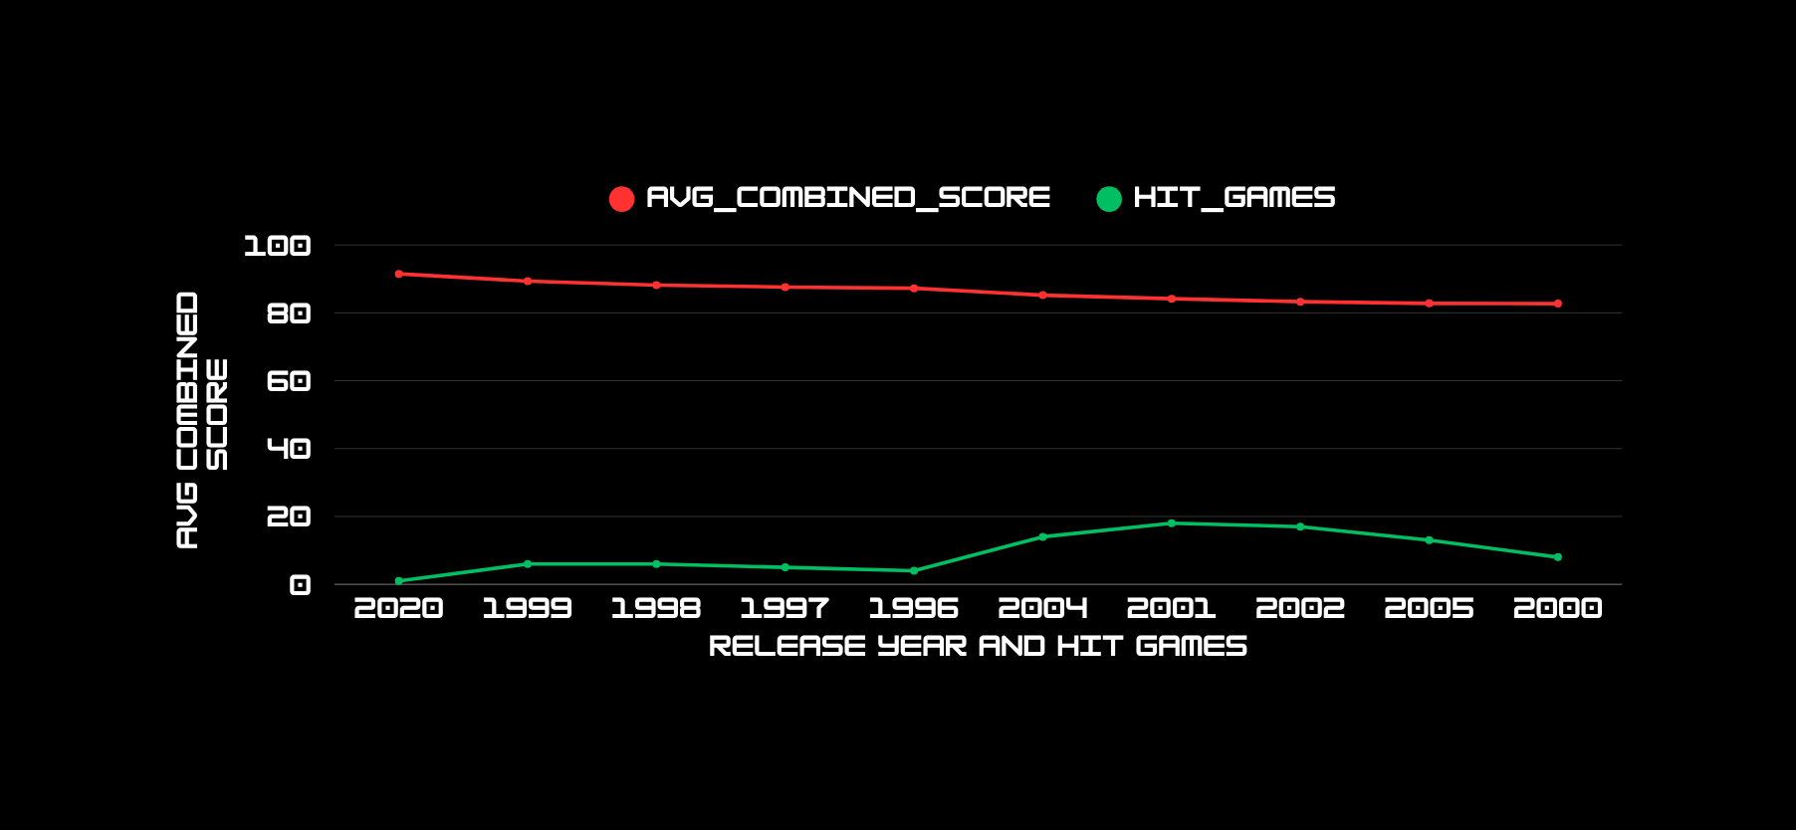


Top 10 Years by Combined Scores
Goal: Present years with the highest combined critic/user scores and hits.
Insight: “2008 shows strong critic-fan alignment (e.g., GTA IV).”
IN “2008: Quality met popularity.”
7

Slide 8
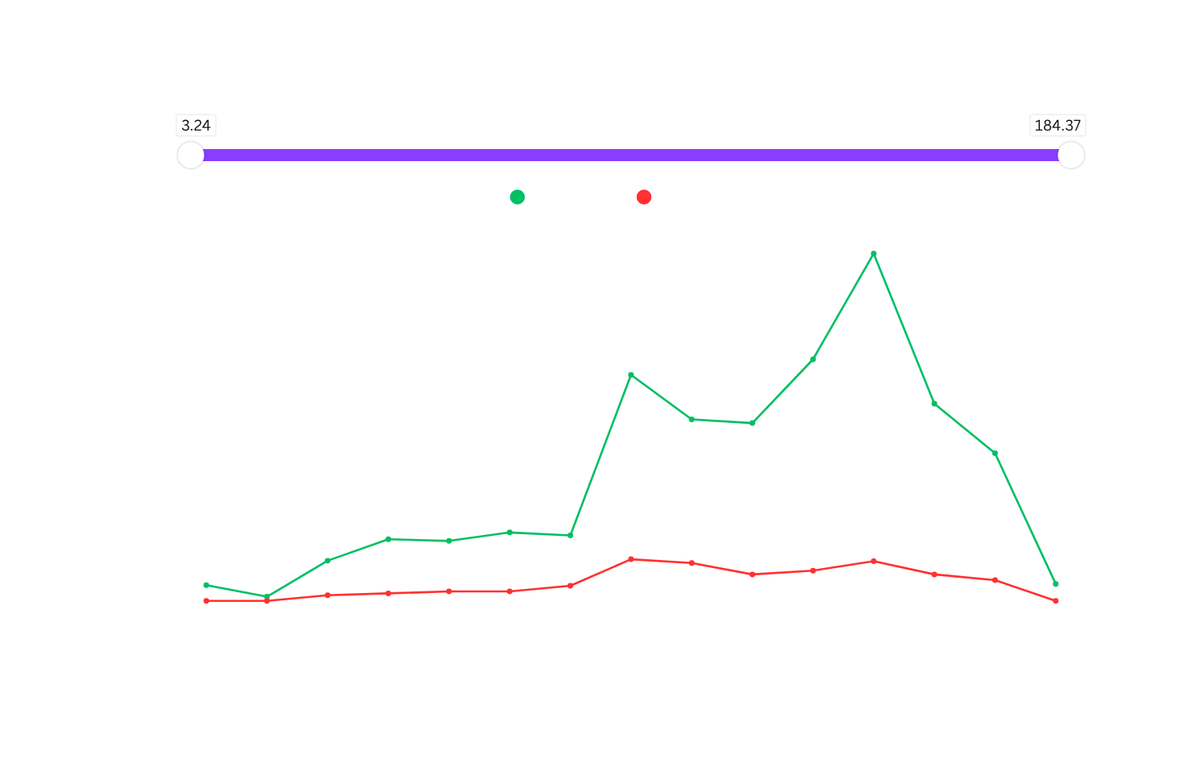

TOP SALES
1994 - 2020
Goal: Display total sales in top years from analyses of 1994 - 2020.
“Wii’s appeal drove 2006–2008 sales.”
SALES WILL BE IN MILLION’S
Insight: “2000–2010 sales peaked with blockbusters like Wii Sports.”
GAMES LIKE : GTA IV - TEKKEN 3 - CALL OF DUTY - SUPER MARIO AND MANY MORE GAINED HIGHES SALES !
8

Slide 9


DEFINING THE GOLDEN AGE
Goal: Propose the Golden Age (e.g., 1998–2012) with evidence, including top 300 games analysis.
Content:
Summary: “The Golden Age is 1998–2012, driven by high sales, scores, hits, and platform/genre trends.”
Rationale:
Top 10 games (2000–2010, e.g., Wii Sports).
Peak scores in 1998, 2004, 2008.
High sales in 2000–2010.
Top 300 games show PlayStation 2 and Action genre dominance
Cultural Impact of Iconic Games:
Insight: “The 1998–2012 period produced culturally transformative games like The Legend of Zelda: Ocarina of Time (1998) and Call of Duty: Modern Warfare (2007), which redefined genres and influenced modern gaming.”
Evidence: Analysis likely includes Wii Sports (2006) and Grand Theft Auto titles (2000s), which were cultural phenomena. Ocarina of Time (1998) from critics ( analysis ) set a benchmark for 3D action-adventure games, scoring ~99/100. Call of Duty (2007) from Analysis 4. popularized online multiplayer shooters.
Why It Matters: Shows how the Golden Age wasn’t just about numbers but also cultural milestones, appealing to the “fan love” aspect of the hook.
9

Slide 10



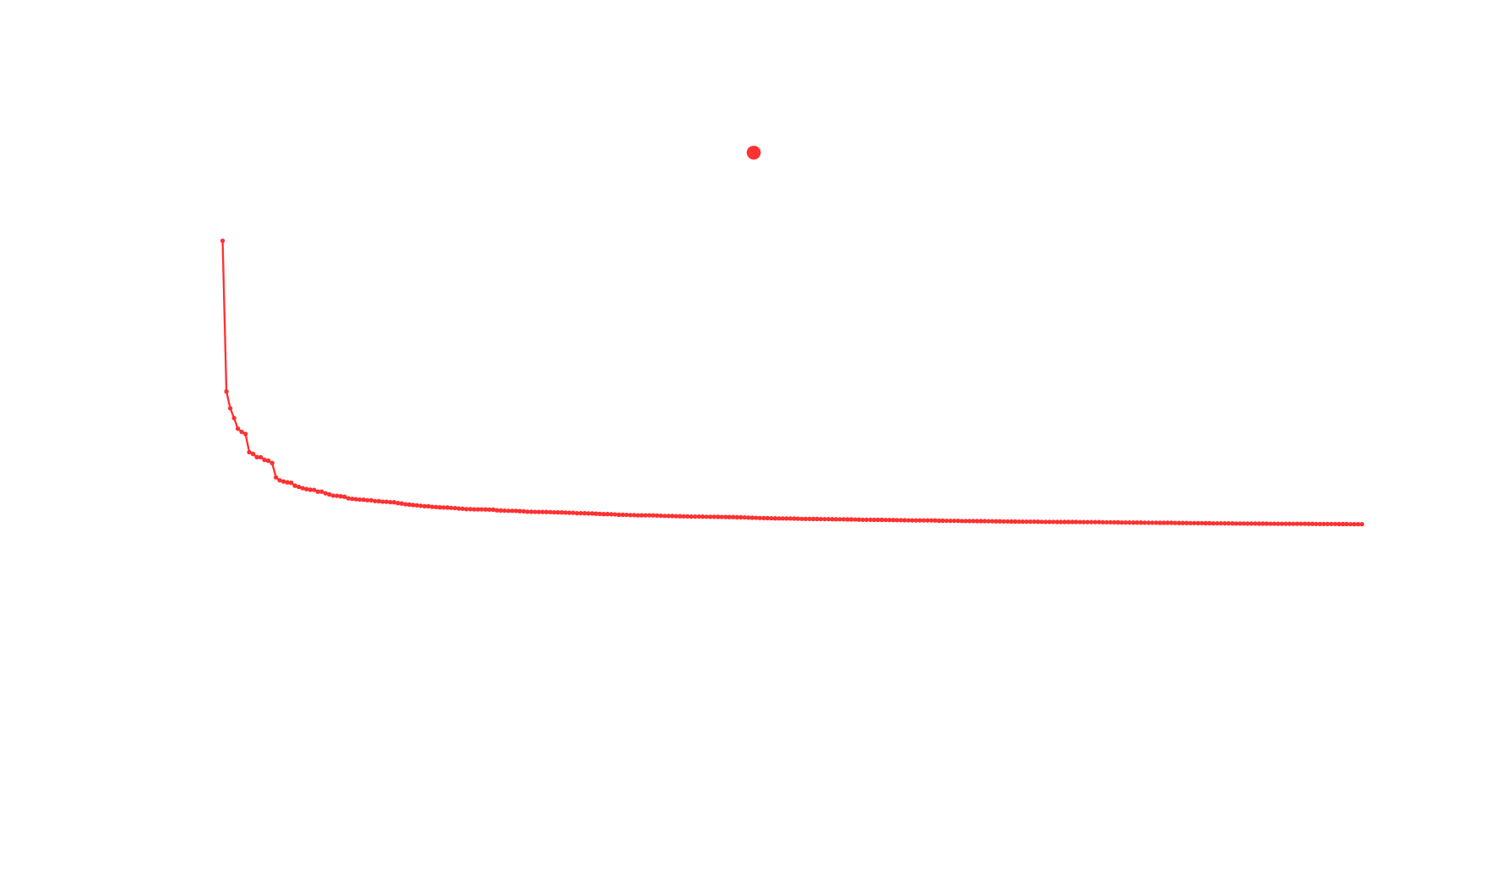
GOLDEN AGE ANALYSIS
ANALYSIS
OF TOP 300 GAMES
SALES IN MILLION
Gaming is Future
10

Slide 11
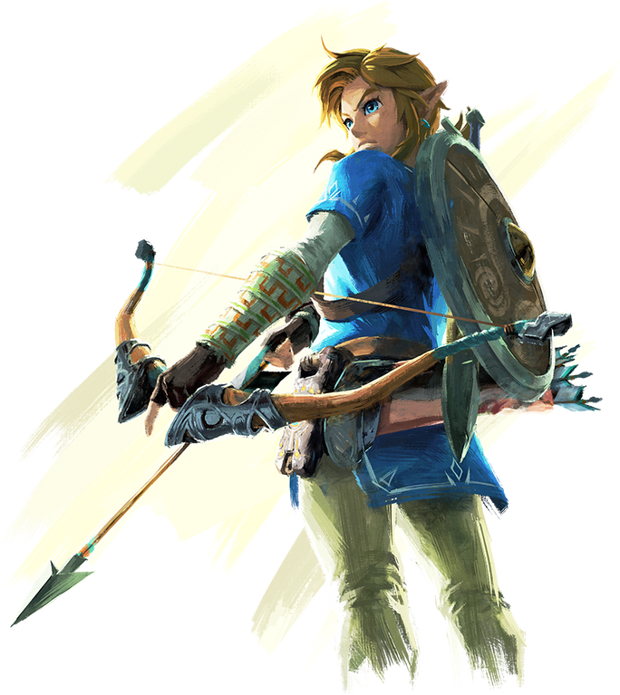



CONCLUSION
Goal: Is to Summarize findings and outline limitations/future work.
Content:
Takeaways:
Golden Age: 1998–2012 (sales, scores, hits).
PS2 and Action genres led to top 300 games.
Limitations:
Top 300 games may miss niche titles.
Possible missing scores or regional bias would be there.
Sorry for The missing Insights .
Future Work:
Next Phase is to Analyze by region or specific platforms.
Iam gonna Add new Games and their insights in the Future.
This Project is Definitely gonna Improve in Future Not from Scratch but with some Add on’s.
page 12

Slide 12





WHAT’S YOUR
NEXT
GOLDEN AGE
SHARE YOUR
THOUGHTS ?
12

Slide 13


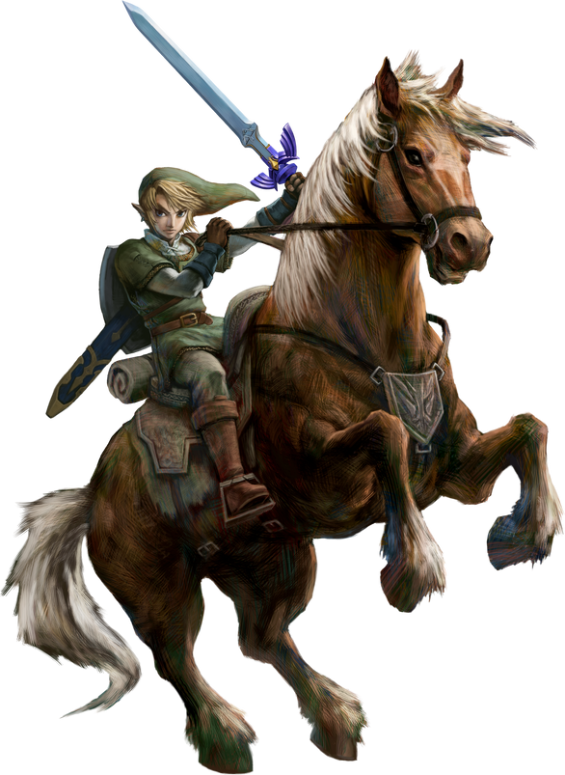
APPENDIX
Goal: Provide technical details for credibility.
Key Queries:
Top 10: SELECT NAME , year_of_release , global_sales FROM cleaned_games ORDER BY global_sales DESC LIMIT 10;
Top 300: SELECT name , platform , genre , ROUND(global_sales, 2) FROM cleaned_games ORDER BY global_sales DESC LIMIT 300;
Data Limitations and Assumptions:
Purpose: Acknowledge limitations to show critical thinking and rigor.
Content:
Dataset Scope: Limited to top 300 best-selling games, potentially missing niche or titles.
Score Availability: Some games lack critic or user scores, affecting averages (e.g., ~10% missing scores in cleaned_games).
Sales Bias: Global sales may over-represent Western markets (e.g., North America/Europe vs. Japan).
Assumption: Assumed normalized user scores are comparable to critic scores.
Time Frame: Data primarily covers 1977–2020, with limited post-2015-2020 insights.
13
Cleaning: Removed duplicate VALUES , normalized scores , defined hits.
Sources: Kaggle dataset (URL) , MySQL , Power BI and canva.
https://www.kaggle.com

Slide 14



"Grind now
glory later."
THANK YOU !
14

